Slide 1
Stochastic Process
Indexed collection of random variables
  {X_{t}} _{t∈Τ} , for each t ∈ T, X_{t} is a random variable
  T = Index Set
  State Space = range (possible values) of all X_{t}
Stationary Process: Joint Distribution of the X’s dependent only on their relative positions. (not affected by time shift) (X_{t1}, ..., X_{tn}) has the same distribution as (X_{t1+h}, X_{t2+h}..., X_{tn+h})
  e.g.) (X₈, X₁₁) has same distribution as (X₂₀, X₂₃)
Notes:
30

Slide 2
Stochastic Process(cont.)
Markov Process: P_{r} of any future event given present does not depend on past:
t₀ < t₁ < ... < t_{n-1} < t_{n} < t
P(a ≤ X_{t} ≤ b | X_{tn} = x_{tn}, ........., X_{t0} = x_{t0})
| future | | present | | past |
P (a ≤ X_{t} ≤ b | X_{tn} = x_{tn})
Another way of writing this:
P{X_{t+1} = j | X₀ = k₀, X₁ = k₁,..., X_{t} = i} =
P{X_{t+1} = j | X_{t} = i} for t=0,1,.. And
every sequence i, j, k₀, k₁,... k_{t-1},
Notes:
30

Slide 3
Stochastic Process(cont.)
Markov Chains:
  State Space {0, 1, ...}
  Discrete Time Continuous Time
  {T = (0, 1, 2, ...)} {T = [0, ∞)} 
  Finite number of states
  The markovian property
  Stationary transition probabilities
  A set of initial probabilities P{X₀ = i} for i
Notes:
30

Slide 4
Stochastic Process(cont.)
Note:
  P_{ij} = P(X_{t+1} = j | X_{t} = i)
  = P(X₁ = j | X₀ = i)
  Only depends on going ONE step
Notes:
30

Slide 5
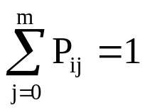
Stochastic Process(cont.)
  Stage (t) Stage (t + 1)
  State i State j (with prob. P_{ij})
  P_{ij}
  These are conditional probabilities!
  Note that given X_{t} = i, must enter some state at stage t + 1
  0 P_{i0}
  1 P_{i1}
  2 with P_{i2}
  ...... prob. .....
  j P_{ij}
  ...... .....
  m P_{im}
Notes:
30

Slide 6
Stochastic Process(cont.)
  Convenient to give transition probabilities in matrix form
  P = P_{(m+1)× (m+1)} = P_{ij}
go to i^{th} state
0 1 2 . . . j . . . m
=
0
1
2

i

m
P₀₀ P_{0j}
P₁₀ P_{1j}
P₂₀ P_{2j}
P_{i0} P_{ij}
P_{m0} P_{mj} P_{mm}
Rows are
given in
this stage
Rows
sum
to 1
Notes:
30

Slide 7
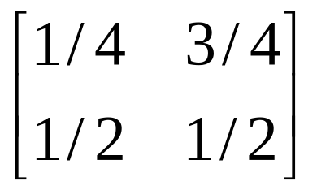
Stochastic Process(cont.)
  Example:
    t = day index 0, 1, 2, ...
    X_{t} = 0 high defective rate on t^{th} day
    = 1 low defective rate on t^{th} day
    two states ===> n = 1 (0, 1)
    P₀₀ = P(X_{t+1} = 0 | X_{t} = 0) = 1/4 0 0
    P₀₁ = P(X_{t+1} = 1 | X_{t} = 0) = 3/4 0 1
    P₁₀ = P(X_{t+1} = 0 | X_{t} = 1) = 1/2 1 0
    P₁₁ = P(X_{t+1} = 1 | X_{t} = 1) = 1/2 1 1
     ∴P =
Notes:
30

Slide 8
Stochastic Process(cont.)
  Note:
    Row sum to 1
    P₀₀ = P(X₁ = 0 | X₀ = 0) = 1/4
    = P(X₃₆ = 0 | X₃₅ = 0)
    Also
    = P(X₂ = 0 | X₁ = 0, X₀ = 1)
    = P(X₂ = 0 | X₁ = 0) = P₀₀
  What is P(X₂ = 0 | X₀ = 0)
    This is a two-step trans.
    stage stage
    0 2
    or t t + 2
Notes:
30

Slide 9
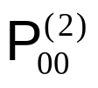
Stochastic Process(cont.)
Stage
Stage
Stage
(t + 0)
(t + 1)
(t + 2)
P
P
00
0
00
0
0
P
1
P
01
10
P(X
= 0, X
= 0 | X
= 0) = P
P
2
1
0
00
00
P(X
= 0
| X
= 0) =
2
0
= P
P
+ P
P
00
00
01
10
= 1/4 *1/4 + 3/4 * 1/2 = 7/16 or 0.4575
Notes:
30

Slide 10
Stochastic Process(cont.)
Performance Questions to be answered
  How often a certain state is visited?
  How much time will be spent in a state by the system?
  What is the average length of intervals between visits?
Notes:
30

Slide 11
Stochastic Process(cont.)
Other Properties:
  Irreducible
  Recurrent
  Mean Recurrent Time
  Aperiodic
  Homogeneous
Notes:
30

Slide 12
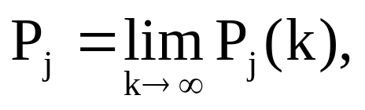
Stochastic Process(cont.)
Homogeneous, Irreducible, Aperiodic
Limiting State Probabilities:
(j=0, 1, 2...)
Exist and are Independent of the P_{j}(0)’s
Notes:
30

Slide 13
Stochastic Process(cont.)
If all states of the chain are recurrent and their mean recurrence time is finite,
P_{j}’s are a stationary probability distribution and can be determined by solving the equations
  P_{j} = Σ P_{i} P_{ij}, (j=0,1,2..) and Σ P_{i} = 1
  ^{i} ^{i}
  Solution ==> Equilibrium State Probabilities
Notes:
30

Slide 14
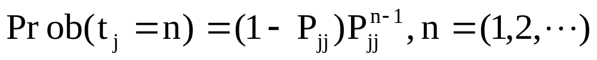
Stochastic Process(cont.)
Mean Recurrence Time of S_{j}:
      t_{rj} = 1 / P_{j}
  Independence allows us to calculate the time intervals spent in S_{j}
  ⇒ State durations are geometrically distributed with mean 1 / (1 - P_{jj})
Notes:
30

Slide 15
Stochastic Process(cont.)
Example: Consider a communication system which transmits the digits 0 and 1 through several stages. At each stage the probability that the same digit will be received by the next stage, as transmitted, is 0.75. What is the probability that a 0 that is entered at the first stage is received as a 0 by the 5th stage?
Notes:
30

Slide 16
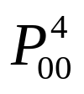
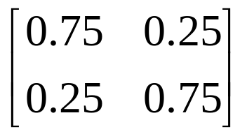
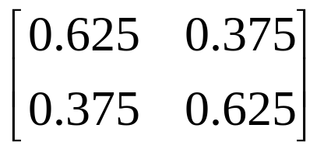
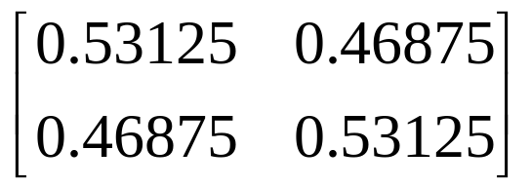
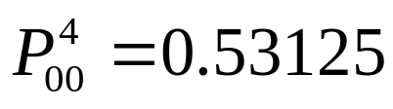
Stochastic Process(cont.)
Solution: We want to find . The state transition matrix P is given by P =
Hence
P² = and P⁴ = P²P² =
Therefore the probability that a zero will be transmitted through four stages as a zero is
It is clear that this Markov chain is irreducuble and aperidoic.
Notes:
30

Slide 17
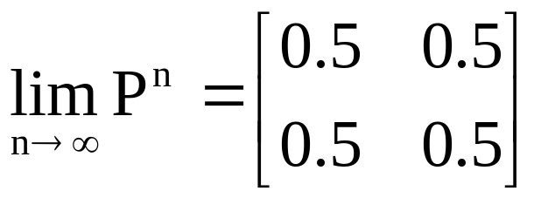
Stochastic Process(cont.)
We have the equations
π₀ + π₁ = 1, π₀ = 0.75π₀ + 0.25π₁ , π₁ = 0.25π₀ + 0.75π₁.
The unique solution of these equations is π₀ = 0.5, π₁ = 0.5. This means that if data are passed through a large number of stages, the output is independent of the original input and each digit received is equally likely to be a 0 or a 1. This also means that
Notes:
30

Slide 18
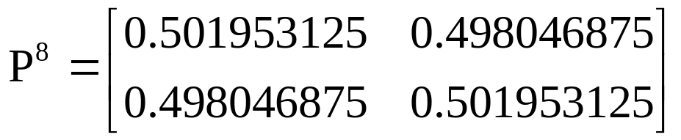
Stochastic Process(cont.)
Note that:
and the convergence is rapid.
Note also that
πP = (0.5, 0.5) = π,
so π is a stationary distribution.
Notes:
30

Slide 19
Example I
Problem:
  CPU of a multiprogramming system is at any time executing instructions from:
    User program or ==> Problem State (S3)
    OS routine explicitly called by a user program (S2)
    OS routine performing system wide ctrl task (S1)
      ==> Supervisor State
    wait loop ==> Idle State (S0)
Notes:
30

Slide 20
Example I (cont.)
Assume time spent in each state ≥ 50 μs
  Note: Should split S₁ into 3 states
  (S₃, S₁), (S₂, S₁),(S₀, S₁)
  so that a distinction can be made regarding entering S₀.
Notes:
30

Slide 21
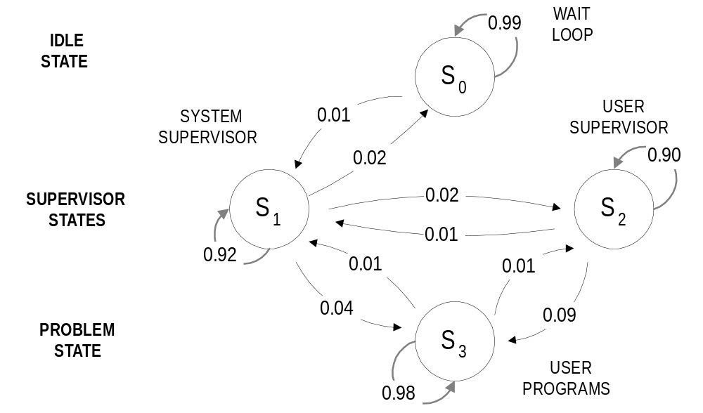
Example I (cont.)
State Transition Diagram of discrete-time Markov of a CPU
Notes:
30

Slide 22
Example I (cont.)
To State
S0 S1 S2 S3
S0 0.99 0.01 0 0
From S1 0.02 0.92 0.02 0.04
State S2 0 0.01 0.90 0.09
S3 0 0.01 0.01 0.98
Transition Probability Matrix
Notes:
30

Slide 23
Example I (cont.)
P₀ = 0.99P₀ + 0.02P₁
P₁ = 0.01P₀ + 0.92P₁+ 0.01P₂ + 0.01P₃
P₂ = 0.02P₁+ 0.90P₂ + 0.01P₃
P₃ = 0.04P₁+ 0.09P₂ + 0.98P₃
1 = P₀ + P₁+ P₂ + P₃
Equilibrium state probabilities can be computed by solving system of equations. So we have:
P₀ = 2/9, P₁ = 1/9, P₂ = 8/99, P₃ = 58/99
Notes:
30

Slide 24
Example I (cont.)
Utilization of CPU
1 - P₀ = 77.7%
58.6% of total time spent for processing users programs
19.1% (77.7 - 58.6) of time spent in supervisor state
11.1% in S₁
8% in S₂
Notes:
30

Slide 25
Example I (cont.)
Mean Duration of state S_{j}, (j = 0, 1, 2,...)
t₀ = 1 ⋅ (50) / (1 - P_{jj}) = 50/0.01 = 5000μs
= 5 ms
t₁ = 50 / 0.08
= 625μs
t₂ = 50 / 0.10
= 500μs
t₃ = 50 / 0.02 = 2.5 ms
Notes:
30

Slide 26
Example I (cont.)
Mean Recurrence Time
t_{rj} = 1 / P_{j}
t_{r0} = 50 / (2/9) = 225μs
t_{r1} = 50 / (1/9) = 450μs
t_{r2} = 50 / (8/99) = 618.75μs
t_{r3} = 50 / (58/99) = 85.34μs
Notes:
30

Slide 27
Stochastic Process(cont.)
Other Markov chain properties for classifying states:
  Communicating Classes:
    States i and j communicate if each is accessible from the other.
  Transient State:
    Once the process is in state i, there is a positive probability that it will never return to state i,
  Absorbing State:
    A state i is said to be an absorbing state if the (one step) transition probability P_{ii} = 1.
Notes:
30

Slide 28
Stochastic Process(cont.)
Note: State Classification:
STATES
Recurrent Transient
Periodic Aperiodic Periodic Aperiodic
Absorbing
Notes:
30

Slide 29
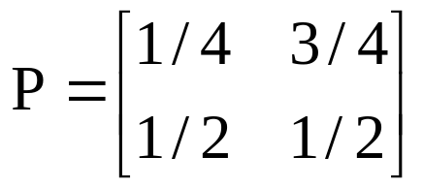
Example II
Example II:
0 0
1 0
1
  Communicating Class {0, 1}
  Aperiodic chain
  Irreducible
  Positive Recurrent
Notes:
30

Slide 30
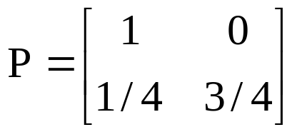
Example III
Example III:
00
1 0 0
1 0
1
  Absorbing State {0}
  Transient State {1}
  Aperiodic chain
  Communicating Classes {0} {1}
Notes:
30

Slide 31
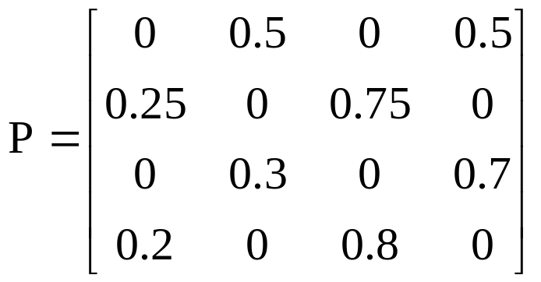
Exercise
Exercise: Classify States.
Notes:
30

Slide 32
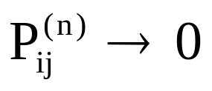
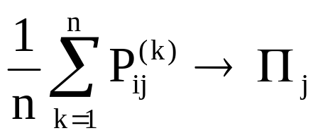
Major Results
Result I:
  j is transient
  P(X_{n} = j | X₀ = i) = as n → ∞
Result II:
  If chain is irreducible:
  as n → ∞
Notes:
30

Slide 33
Major Results(cont.)
Result III:
  If chain is irreducible and aperiodic:
  P_{ij}^{(n)} → Π_{j} as n → ∞
  P^{(n)} = Π₀  Π₁ ... Π_{j}
  Π₀ Π₁ ... Π_{j}
Π₀ Π₁ ... Π_{j}
   
     Π₀  Π₁ ...  Π_{j} 
Notes:
30

